Slide 1
HUMAN POPULATION & ENVIRONMENT
Prepared by Sir Evan Diengdoh

Slide 2
POPULATION GROWTH
Human population growth increased from:
1 to 2 billion, in 123 years.
2 to 3 billion, in 33 years.
3 to 4 billion, in 14 years.
4 to 5 billion, in 13 years.
5 to 6 billion, in 11 years.
Not the census figures alone that need to be stressed but the impact of natural resources on rapid increase population.

Slide 3
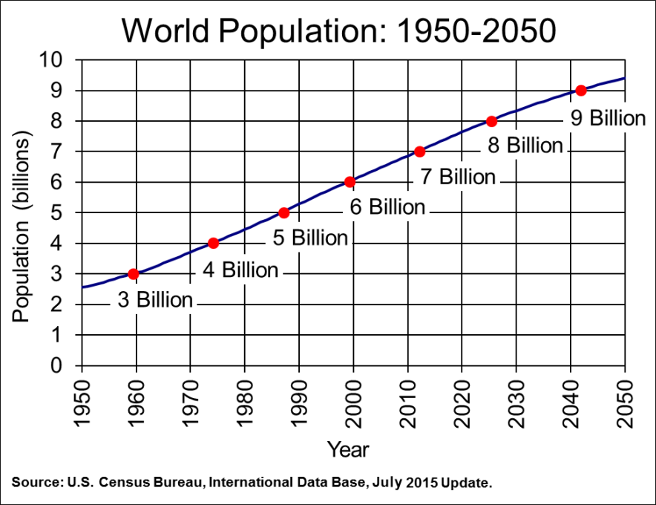
World population

Slide 4
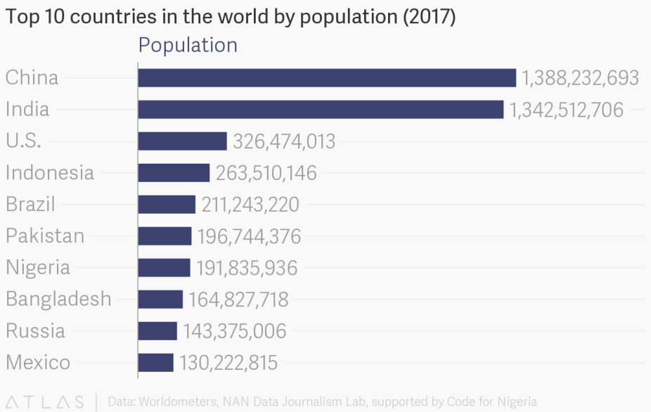
POPULATION GROWTH, VARIATIONS AMONG NATIONS
According to the United Nations, Department of Economic and Social Affairs, Population Division , the world’s population numbered nearly 7.6 billion as of mid-2017

Slide 5
China and India remain the two most populous countries of the world
Global human population is growing by 1.10 per cent per year, yielding an additional 83 million people annually.
The world’s population is projected to increase by slightly more than one billion people over the next 13 years, reaching 8.6 billion in 2030 (United Nations, Department of Economic and Social Affairs, Population Division (2017))

Slide 6
Growth of population have led to a lot of environmental problems.
Due to the changing climate conditions and famines there is decrease production of per capita of agricultural produce at the global level. In some countries, food shortage has become a permanent feature. Eg: malnutrition in South Africa.

Slide 7
MAJOR PROBLEMS OF POPULATION GROWTH
Food and water shortage
Unemployment.
Poverty.
Illiteracy.
Slums.

Slide 8
POPULATION EXPLOSION. The need for Family Welfare Programme
In response to population growth, India seriously took an initiative on Family Planning Programme later rename as Family Welfare Programme:
Slogans such as “Hum do hamare do” indicate that each family should not have more than two children. It however has taken several decade to become effective.

Slide 9
At the global level by the year 2000, 600 million (57%) of women in the reproductive age group, were using some method of contraception.
Temporary methods of family planning include Oral Contraceptive pills, Emergency pills, Intrauterine devices for women and the use of condoms for men.
Permanent methods of family planning includes Vasectomy and Tubectomy- (sterilization)
China has been using permanent sterilization more effectively than any other countries.

Slide 10
WAYS & MEANS…
Awareness.
Print and electronic media.
Edutainment.

Slide 11
THANK YOU
Any Question???

